Slide 1

Scarlet ReThreads
Emily Jepsen, Darryl Bautista, Khushi Patel, and Michael Cicio Oliveira

Slide 2
Business Concept
Scarlet ReThreads is a student-run Rutgers thrift store focused on providing affordable, sustainable, and stylish clothing to the Rutgers community. The store curates gently used apparel, accessories, and Rutgers-themed items, giving students a budget-friendly alternative to traditional retail while promoting environmentally responsible shopping. By encouraging clothing reuse and offering unique, one-of-a-kind pieces, Scarlet ReThreads aims to reduce waste, support campus sustainability, and create a fun shopping experience tailored to student style.

Slide 3
Customer Value Proposition
Scarlet ReThreads offers Rutgers students, staff, and alumni affordable, curated thrifted Rutgers merchandise that promotes school pride while supporting sustainability. By providing unique, budget-friendly apparel in an accessible campus environment, Scarlet ReThreads delivers a more sustainable and cost-effective alternative to traditional Rutgers retail.

Slide 4
Vision Statement, Mission Statement, Statement of Core Values
Vision: To promote sustainable fashion and school pride by making Rutgers style accessible to everyone in the community.
Mission: Scarlet ReThreads serves Rutgers students, staff, and alumni by offering affordable, curated thrifted Rutgers merchandise in an accessible and sustainable shopping environment that provides a unique, budget-friendly alternative to traditional campus retail.
Statement of Core Values: Scarlet ReThreads is committed to accessibility, sustainability, community, and inclusivity. We keep prices affordable so anyone connected to Rutgers can show school pride. We promote sustainability through clothing reuse, donations, and reducing textile waste. We foster community by creating a space that connects the Rutgers network, and we maintain an inclusive environment that welcomes individuals of all backgrounds.

Slide 5
Financial and Strategic Objectives
Financial:
Achieve $20,000 in total sales revenue by the end of the first 6 months of business
Reach monthly break-even profitability within half of the year of launching on the campus store
Secure $3,000 in startup funding through university grants, partnerships, or fundraising within the first 2 months.
Strategic:
Acquire at least 60 new customers per month in the first year through advertising, social media, and campus posters.
Collect at least 800 donated Rutgers merchandise items within the first academic year.
Have at least 25% of customers who visit our website make at least a $25 or more purchase within the first year of operation

Slide 6
Corporate Social Responsibility
Key Initiative: Clothing Donation Drives
Rationale: Encourages students and alumni to donate gently used rutgers merchandise, increases inventory, and promotes sustainable behavior on campus.
Key Initiative: Partnerships
Rationale: Partnering with Rutgers sustainability offices or clubs strengthens credibility and integrates the store into existing campus environmental initiatives.
Key Initiative: Student discount
Rationale: Offer discounts to low-income students and donate a portion of profits to campus causes or emergency funds.

Slide 7
New Product/Service
Textbook Donations
Students can donate gently used textbooks they no longer need, promoting sustainability and affordability.
A dedicated in-store section with feature donated textbooks, allowing students to easily find materials for their course.
Books will be organized by subject to ensure a simple, efficient, and accessible browsing experience.

Slide 8
National Expansion
Decision: Yes
Approach: Franchise
Rationale: Scarlet ReThreads is not Rutgers exclusive. The concept can be utilized in Universities all around the United States, and around the world as well. Expansion grows profit. Franchising allows the business to expand quickly across universities with lower costs and risk while keeping a consistent brand. Each campus can be run locally by students, making it easier to source thrift items and textbook donations while adapting to campus specific demand.

Slide 9
Global Expansion
Selected Country: Canada
Opportunities:
Similar culture to the US
Low political risk
Easy market entry for U.S. Based companies
Strong economy
Minimal language barrier
Strong legal protections
Rationale: Canada offers low risk and a smooth transition for expanding internationally. The culture is similar and there is a very minimal language barrier, making business easy.
Challenges:
Smaller population than some larger countries
More competitive market
Higher taxes in some provinces

Slide 10
Expansion and Entry Strategy
Expansion strategy (global, local, combo): Global standardization expansion
Entry strategy (Franchise, etc.): Franchise
Rationale: Franchising is the best entry strategy for Canada because universities there have similar student needs, such as affordable clothing, textbooks, and dorm essentials. Using franchise partners in Canadian college cities would reduce startup costs, lower operational risk, and allow local operators to source inventory and understand campus trends better. This makes expansion faster, more scalable, and easier to adapt to different university markets while keeping the core thrift store concept consistent.

Slide 11
Key Job
Key job selected: Cashier
Summary of responsibilities: Help customers locate merchandise, use the cash register to check customers out, keep the store neat and organized, maintain a professional and welcoming environment
Qualifications required: Customer service, strong social skills, money handling, ability to work in stressful environments, flexibility for working hours (weekends and weekdays)
Compensation plan: Begin with minimum wage, yearly raises based on performance, PTO, student worker benefits, employee discount on merchandise
Advertising plan: Advertise online to students and local areas, use Indeed or other online platforms, advertise on campus by putting up flyers
Criteria for selection: Previous customer service or retail experience (preferred but not required), strong communication skills, positive attitude and professional appearance, reliable work history and punctuality, interest in sustainability, affordability, and supporting fellow students, availability during peak store hours

Slide 12
Employee Motivation Initiatives
Breaks will be on business time, so the employees are paid for the breaks
Offer constructive feedback on employee’s work.
Incentive Programs: Implementing performance-based incentives, such as bonuses for exceptional customer service or achieving sales targets, can encourage employees to go above and beyond in their roles.
Team Building Activities: Organizing regular team-building events and social gatherings fosters camaraderie among staff, enhancing teamwork and creating a positive work environment.
Create a suggestion box

Slide 13
Departure Announcement
Dear Team,
We want to address the recent departure of two valued members of our organization. Their departure has prompted us to reflect on our management practices and workplace environment. It has become clear that a greater focus is needed on employee motivation, engagement, and professional growth. Moving forward, we will implement several new initiatives to ensure better support and more motivation for employees.
Performance Recognition Program
Flexibility in Scheduling
Career Development/Training Opportunities
Monthly feedback meetings
In-Store Employee Discounts
We truly appreciate the hard work each of you contributes to making Scarlet ReThreads successful. Your effort directly impacts students across campus who rely on affordable clothing, dorm essentials, and textbooks.
If you have any concerns or ideas, our door is always open. We are committed to building a stronger team together.
Thank you for your dedication and continued support.
Sincerely,
The Management Team

Slide 14
Employee Engagement
Foster open communication between leadership and employees so everyone feels heard and valued
Involve employees in decision-making to increase ownership and commitment to the organization’s success
Clearly define organizational goals and show how each employee’s work contributes to the overall mission
Promote a positive workplace culture built on trust, collaboration, respect, and work-life balance
Encourage teamwork to strengthen relationships and improve collaboration among employees
Empower employees by giving them greater autonomy and responsibility in their roles

Slide 15
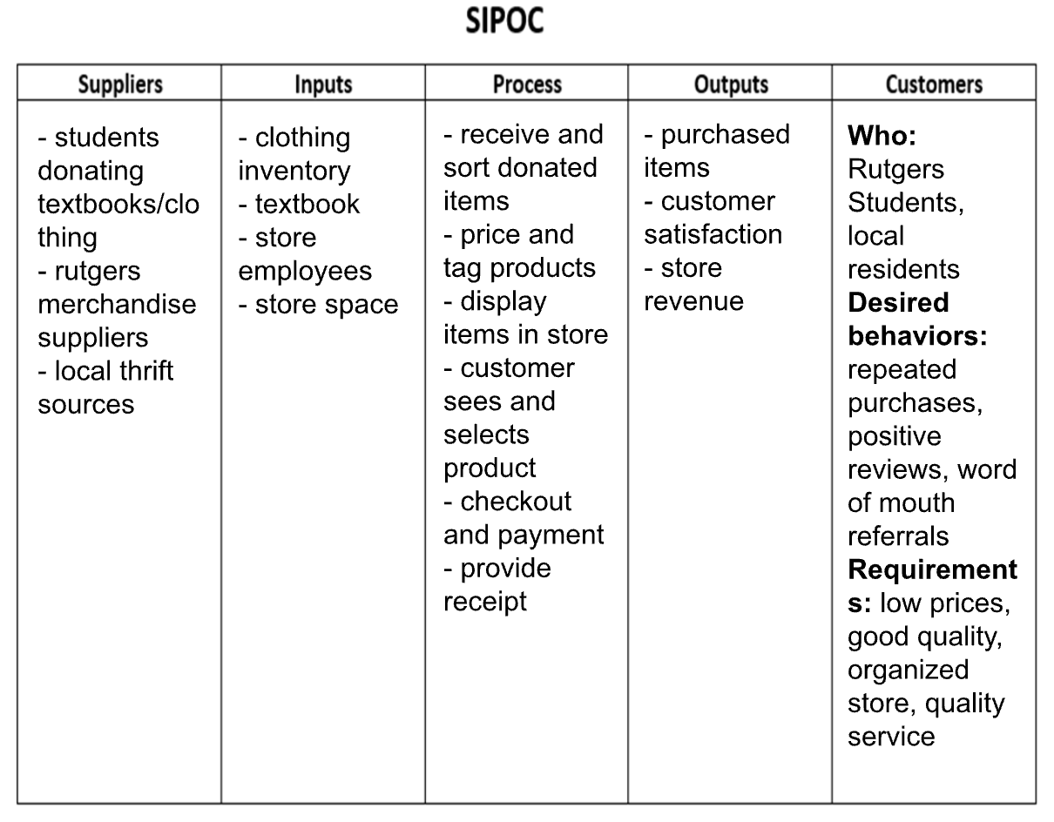
SIPOC

Slide 16
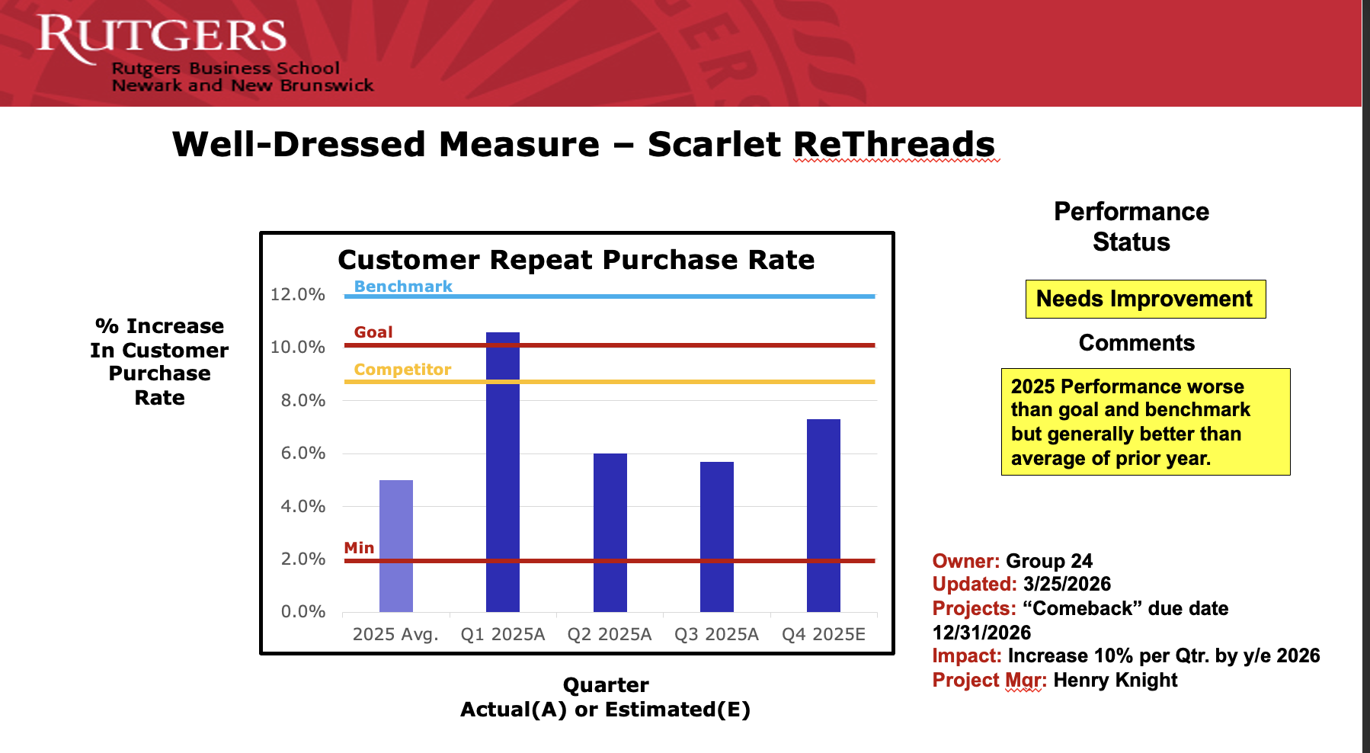
Effectiveness Measurement Chart

Slide 17
Business Success
Scarlet ReThreads has been successful by providing affordable, sustainable clothing while promoting school pride within the Rutgers community. The business meets student needs, operates with low costs through donations, and has strong expansion potential. Its focus on sustainability and community impact makes it both financially and socially successful.

Slide 18
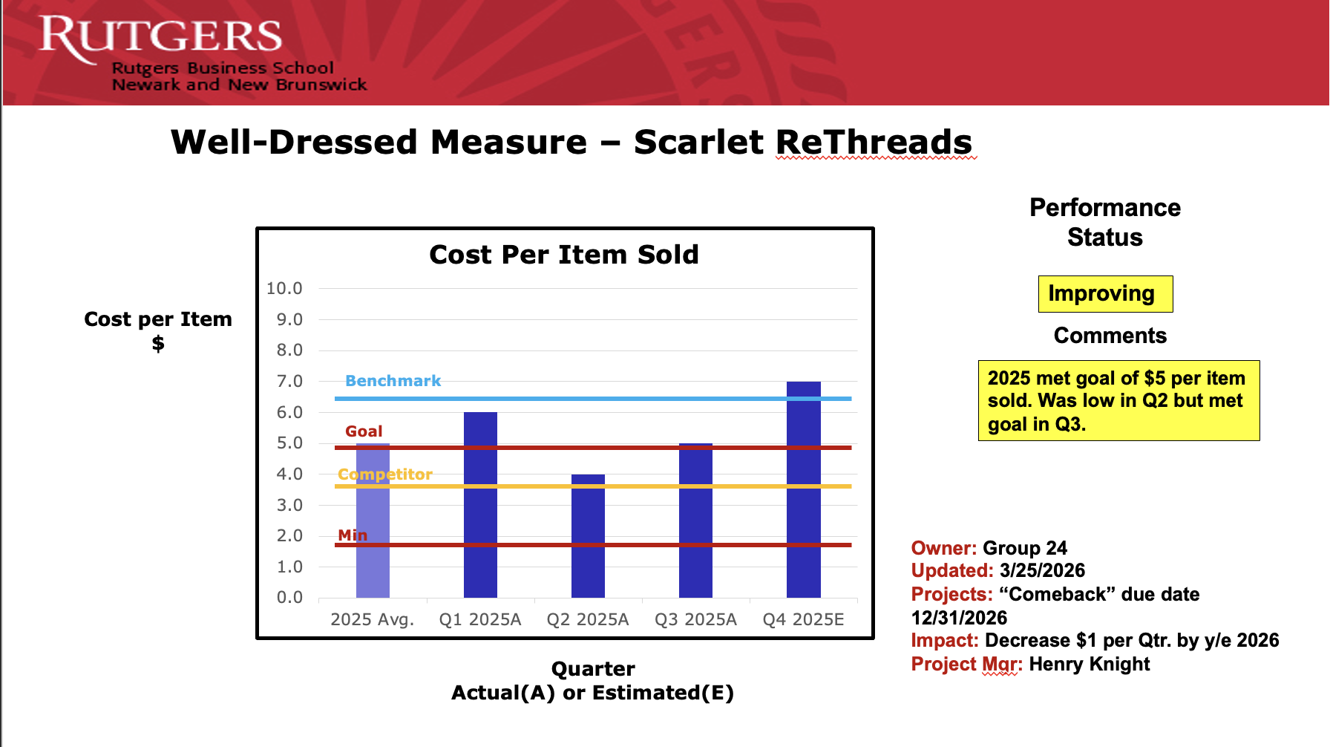
Efficiency Measurement Chart

Slide 19
Key Initiative to Improve the Process
A standardized sorting and pricing system will be implemented to improve efficiency. This will help reduce the time needed to process donations, ensure consistent pricing, and allow products to reach the sales floor faster, increasing overall productivity.

Slide 20
Sell the Business?
Decision:
Do not sell the business
Rationale:
Scarlet ReThreads has strong growth potential through expansion to other universities. Maintaining ownership allows the team to continue scaling the business and increasing long-term profitability rather than giving up future value.

